Slide 1
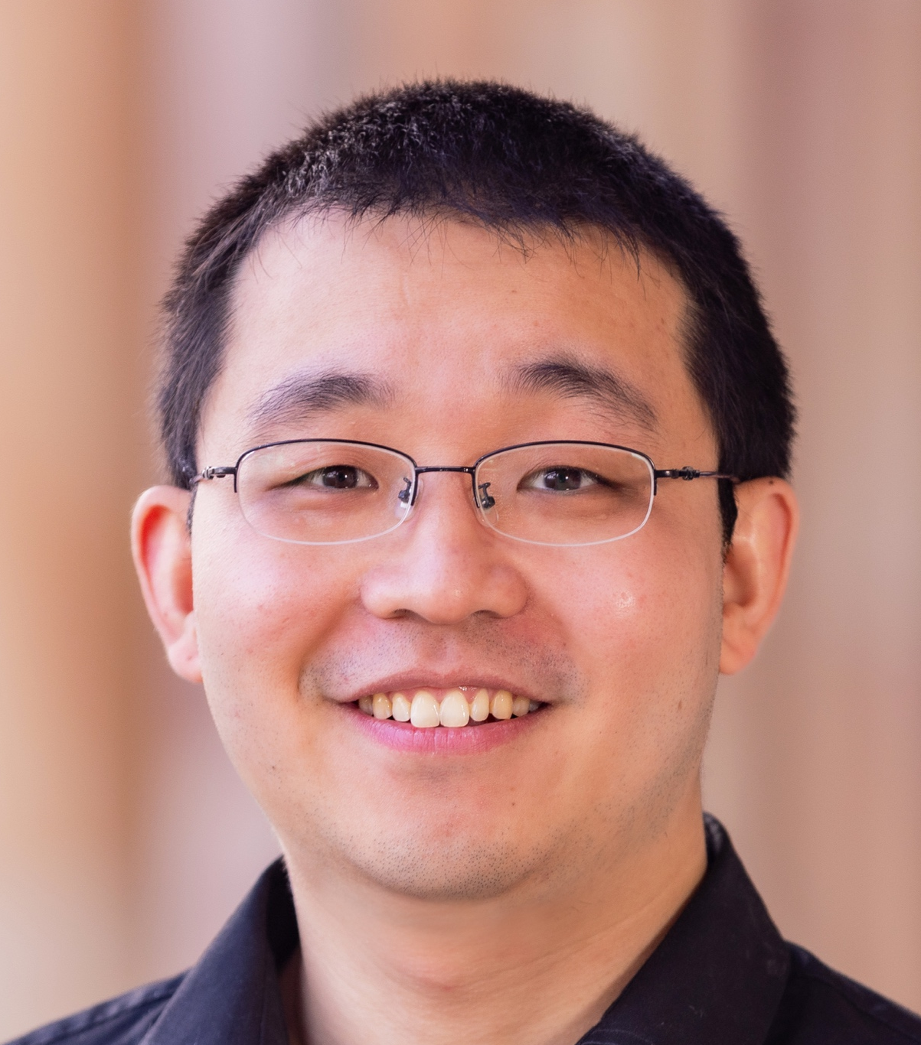
Fast Fourier Transform (FFT): for engineers in the making
Dr. Xiao Guo
School of EECS,
The University of Queensland,
Brisbane, Australia.
2026 July 14 at UQ
E-mail: xiao.guo@uq.edu.au

Slide 2



Outline
Why Fourier Transformation (FT)?
Discrete FT(DFT) and Fast FT (FFT)
What happens and what is it?
How to do it fast?
When/Where we need it?
Test yourself ☺
Take home messages
Notes:
Basically, no complicated math as our undergraduate stude in nts shut down the brain or close the video recording if full of math

Slide 3


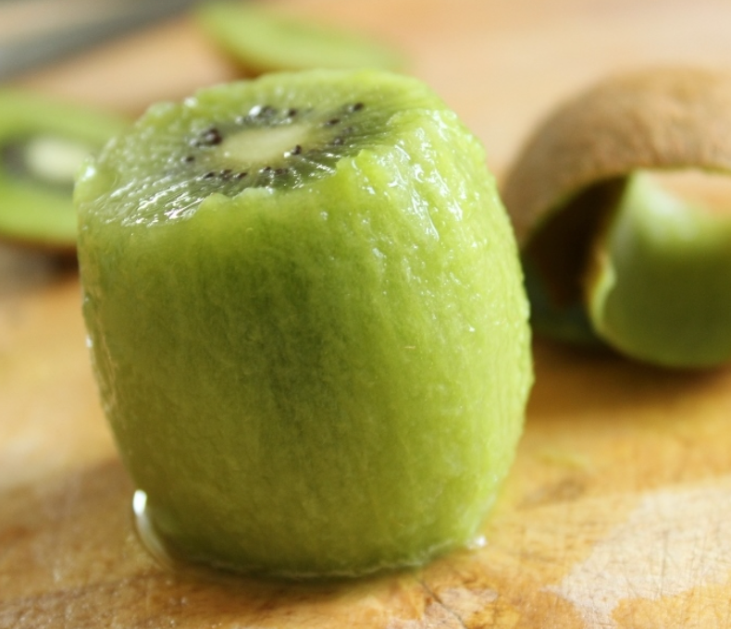
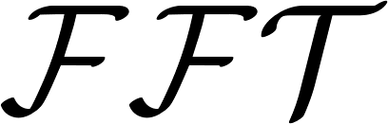

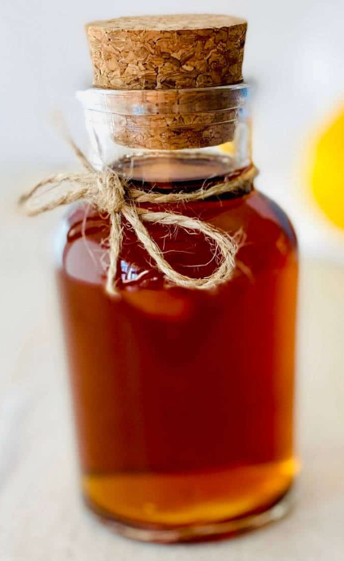
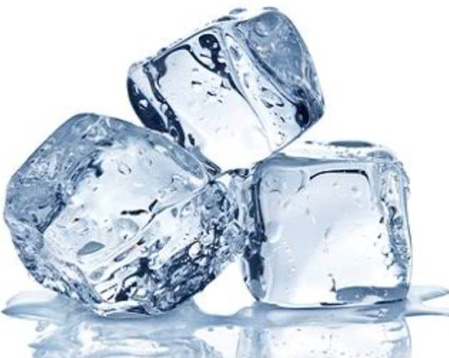
Why FT? “Unblend” a Baby Yoda Cocktail
Grey goose vodka
Let’s see a real example
Peeled Kiwi
Fresh Lime Juice
Demerara sugar syrup
Ice
FT helps to recognise the constituent components

Slide 4

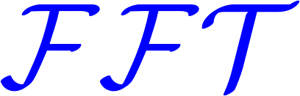
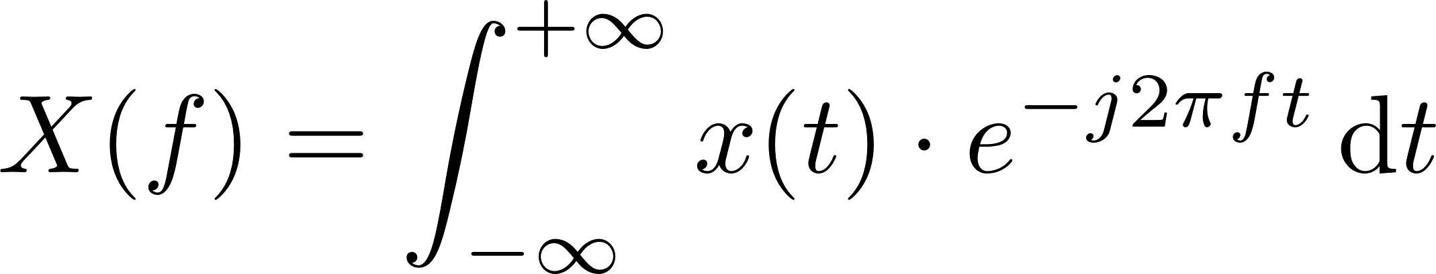
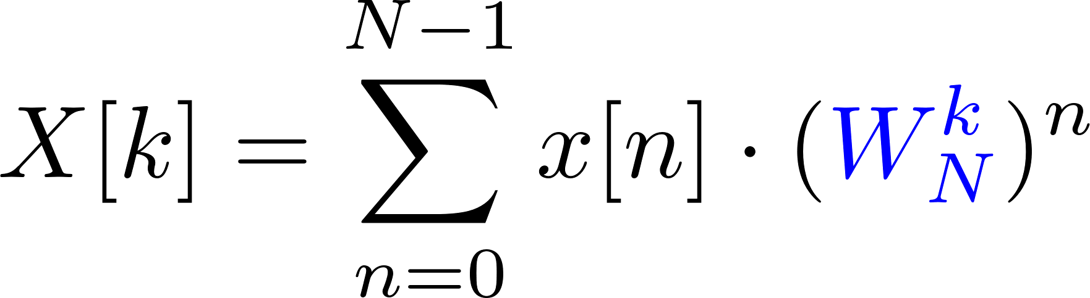
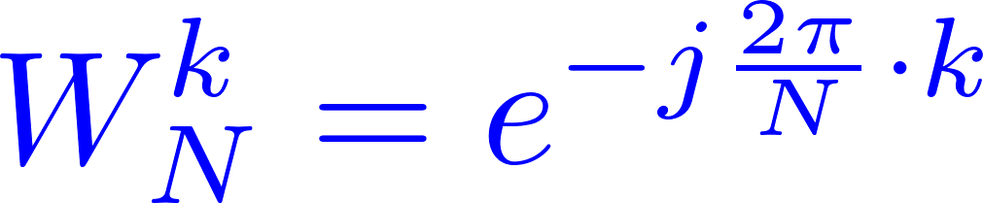
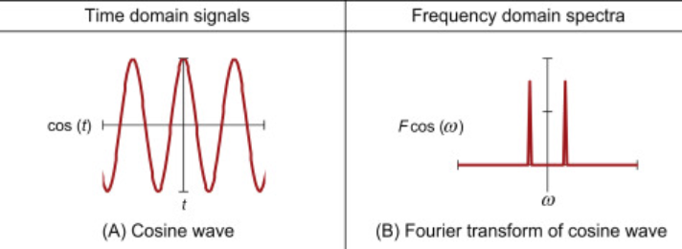
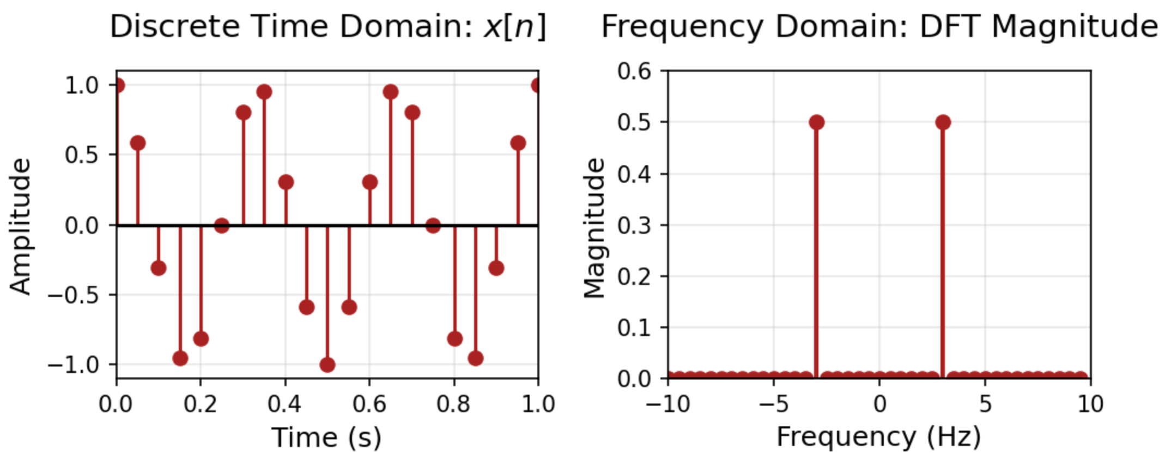
What is FT, DFT, FFT
Slow down – 1 min
IEEE Top 10 Algorithms of the 20th Century
Fourier Transform
ELEC2004
Engineer Choice
Mathematically correct
Digitise signals for digital devices
A bit slow
Much Faster DFT
FFT helps to recognise the constituent components
Notes:
FT – time to frequency domain – small # of improtant freq. compoentns – same in cocktail small number of ingreadients
DFT – digital
FFT – quick
Skip how Gauss boringly did it, ridiculously boring math for physics students, not to mention engineering students

Slide 5




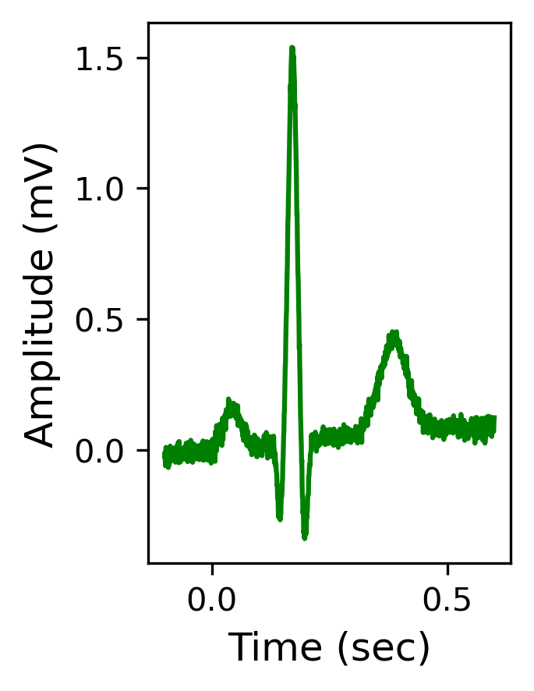
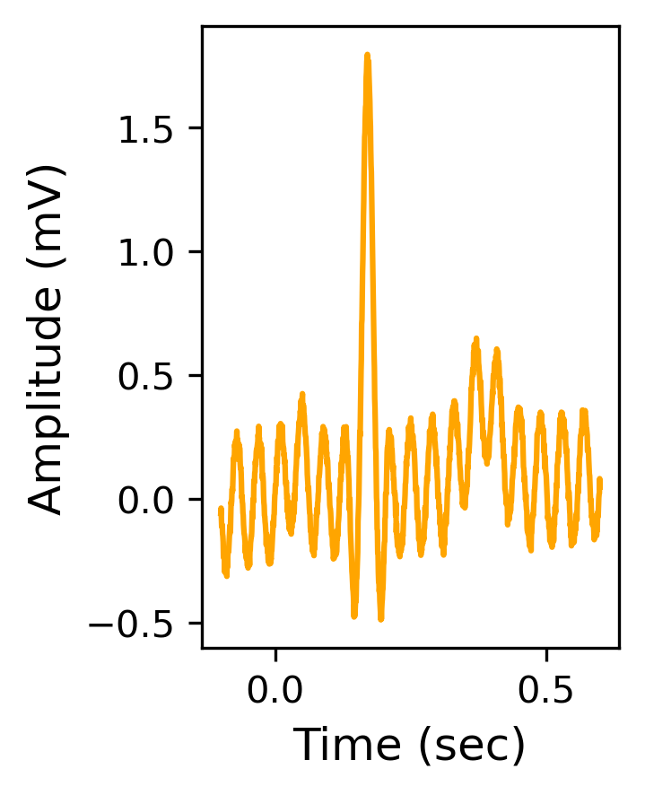
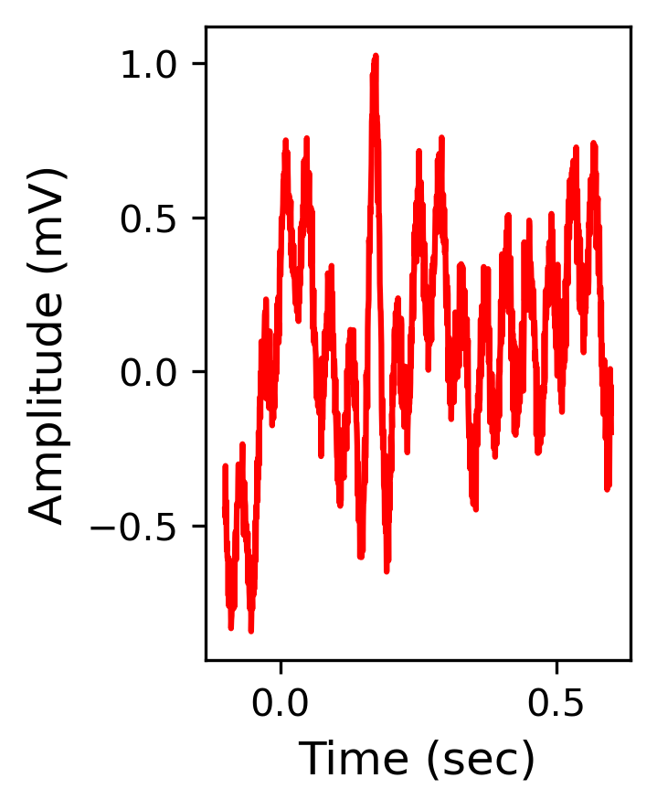
Why do we need Fast Fourier Transformation (FFT)? (1)
e.g., 70 beats/min
Normal
Stressful
Heart Attack
Too complicated, what to do?
A sensor gives us a complicated waveform, we need to understand it
Heart signal generation: McSharry et al. IEEE Transactions on Biomedical Engineering 50.3 (2003): 289-294
Notes:
Use the logic chain to show it can be used for all applications at the take-home message slide to call back
bpm = 70

Slide 6
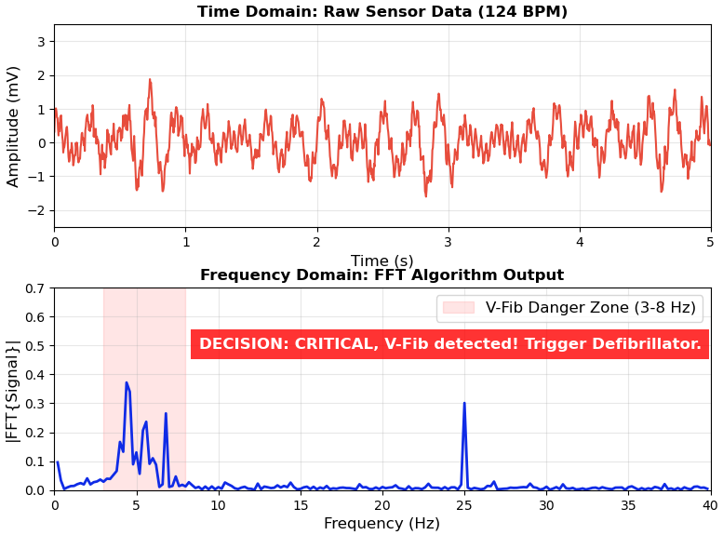
Why do we need Fast Fourier Transformation (FFT)? (2)
Let’s see it in Jupyter Notebook (30 sec).
Data Collection
Heart Attack
(Signals)
Sensor (Hardware)
Frequency Info.
Decision (Action Required)
A sensor gives us a complicated waveform,
FFT helps to understand our data & make decisions ☺
Muscle & noise: Friesen et al. IEEE Transactions on Biomedical Engineering 37.1 (1990): 85-98.
Notes:
Why doctor looks at time-domain not frequency signal
-
The doctor is trained to read time-domain
If there is machine-assisted diagnosis, it is easier to check
Computer-assisted diagnosis

Slide 7
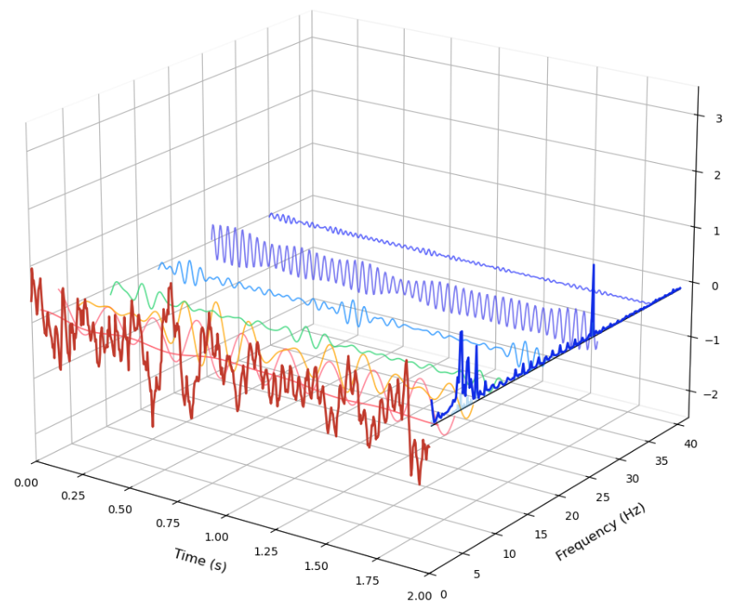
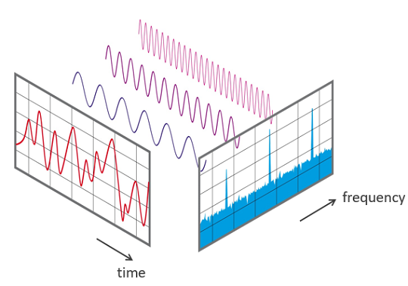
Really, what happens?
We measured a complicated time-varying signal (in time domain).
FFT helps to find another way to present it (in frequency domain).
Major contributors plotted
Notes:
Use the logic chain to show it can be used for all applications at the take-home message slide to call back

Slide 8
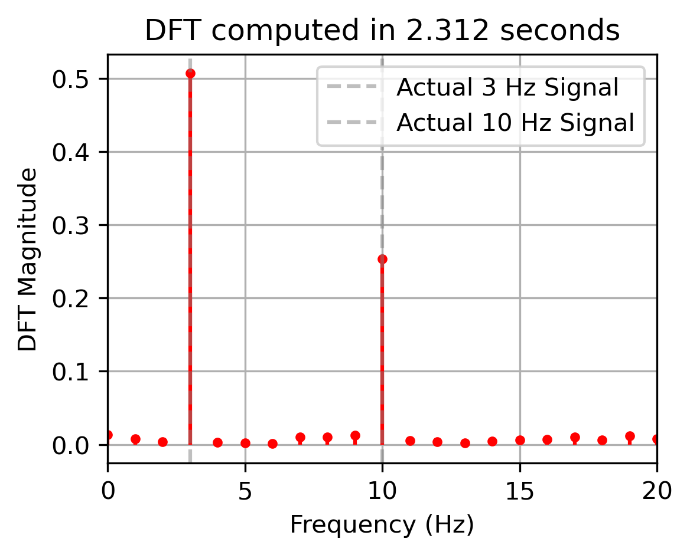
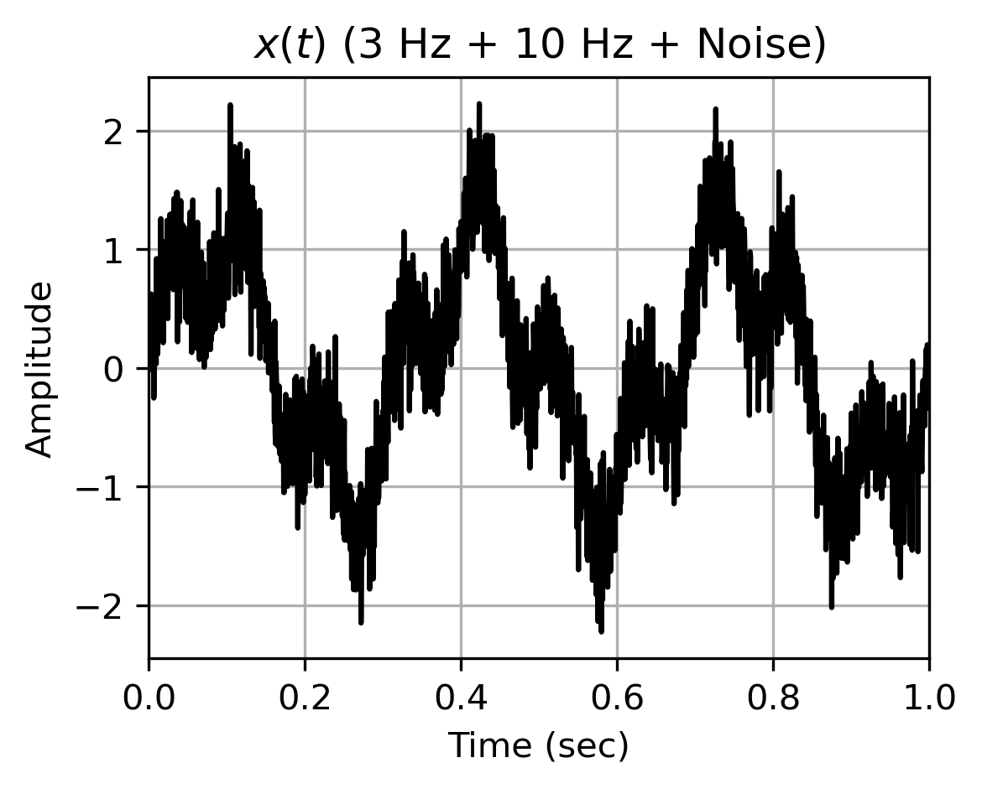
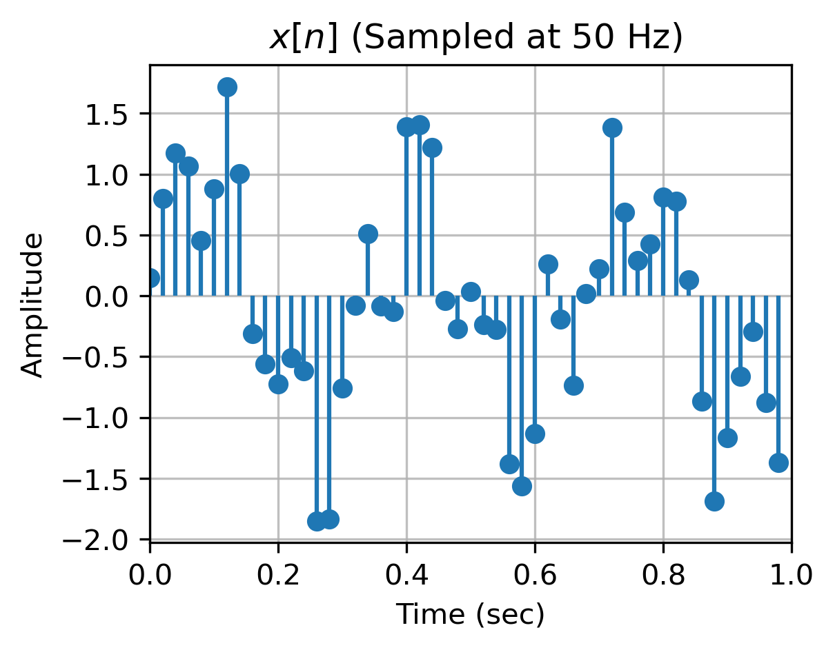
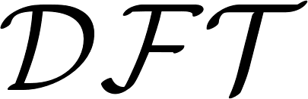
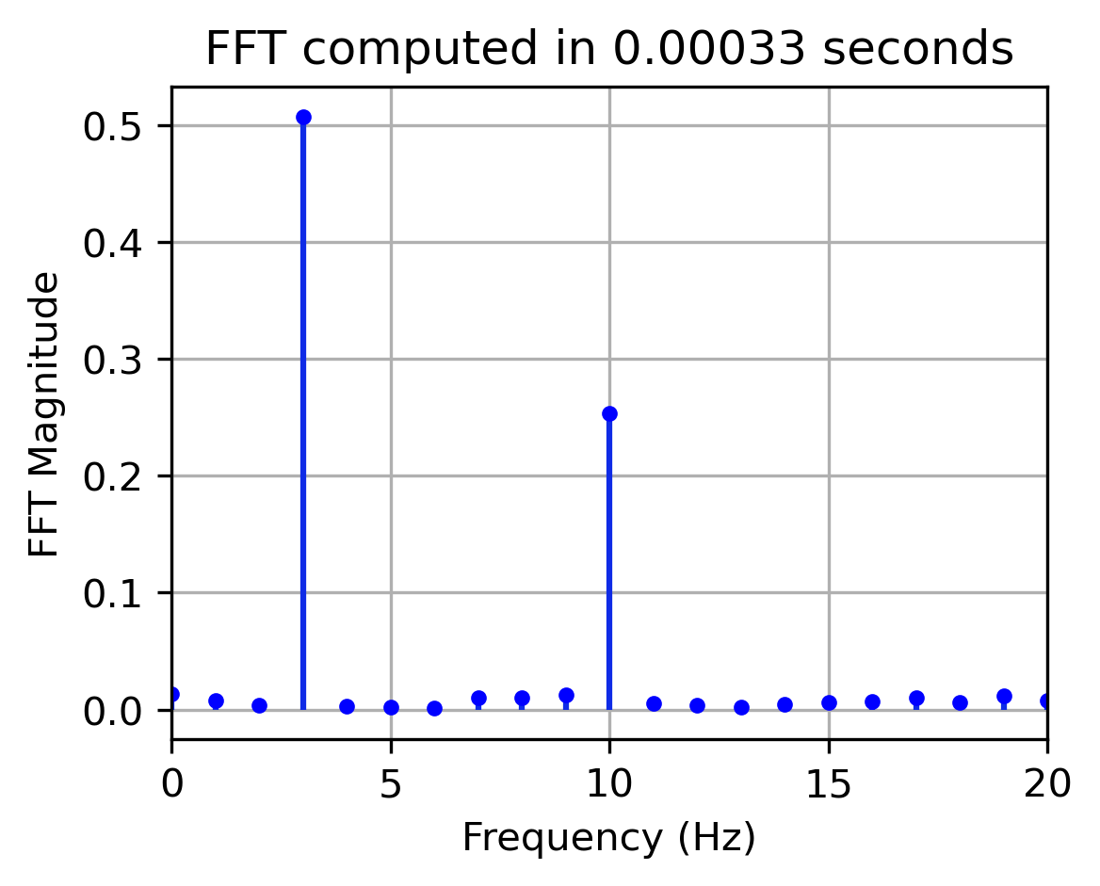
What is Fast Fourier Transformation (FFT)? (1)
Fourier Integral → Discrete Fourier Transform (DFT) → FFT
Notes:
Use the logic chain to show it can be used for all applications at the take-home message slide to call back

Slide 9
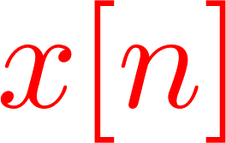
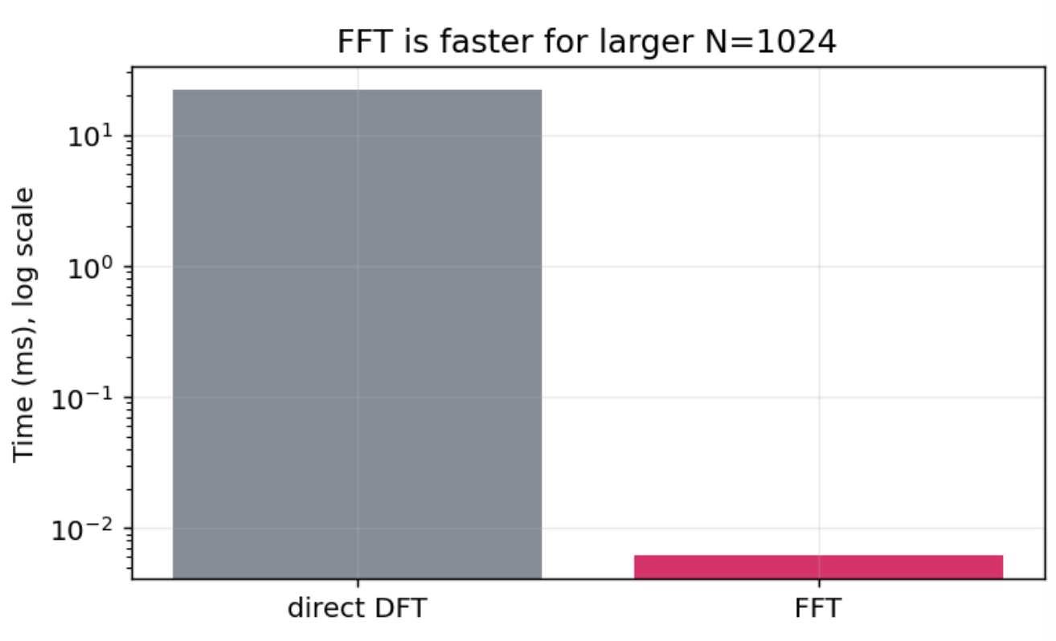
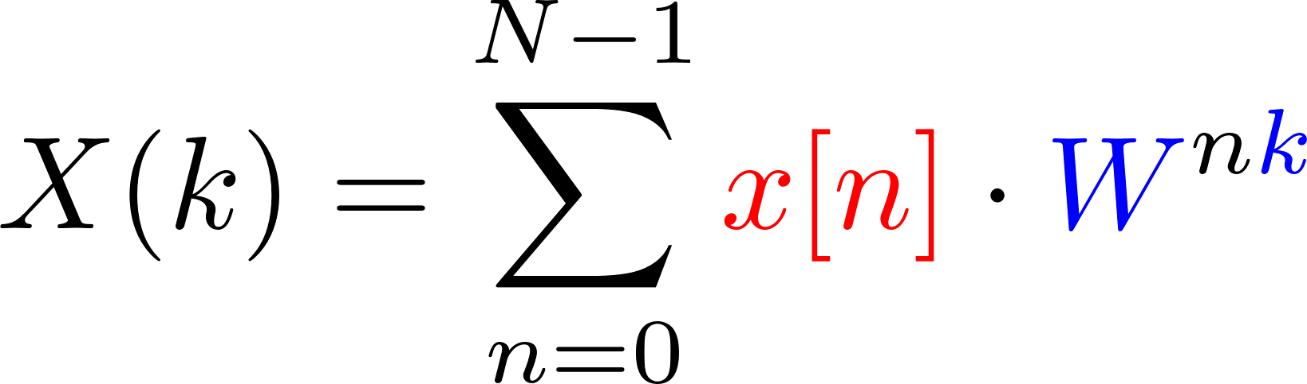

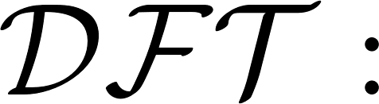
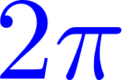
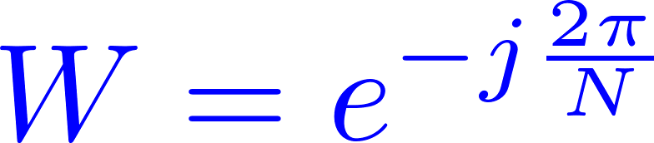
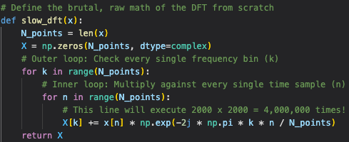

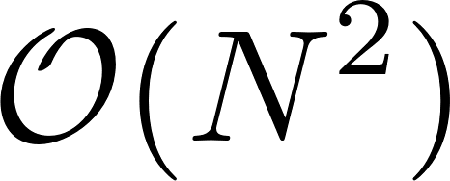
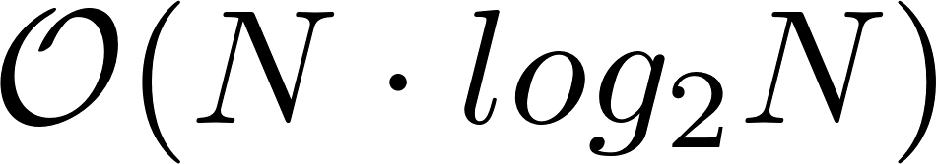
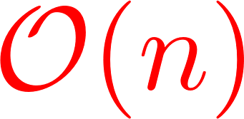
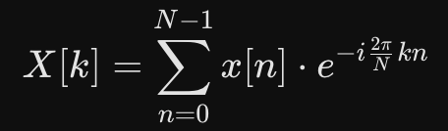
What is Fast Fourier Transformation (FFT)? (2)
A fast version to implement Discrete Fourier Transform (DFT)
time-domain signal
# Spin frequency
# N-slice of
If you want to code:
how an algorithm's execution time scales as the input size (n) grows
Use Optimised FFT libraries, e.g., Numpy, pyFFTW (Python) or FFTW (C/C++) or Matlab
Y = fft(X)
Notes:
Big O notation O(n) how an algorithm's execution time or memory usage scales as the input size (n) grows
Passing a float like 2000.0 will cause the function to fail.

Slide 10
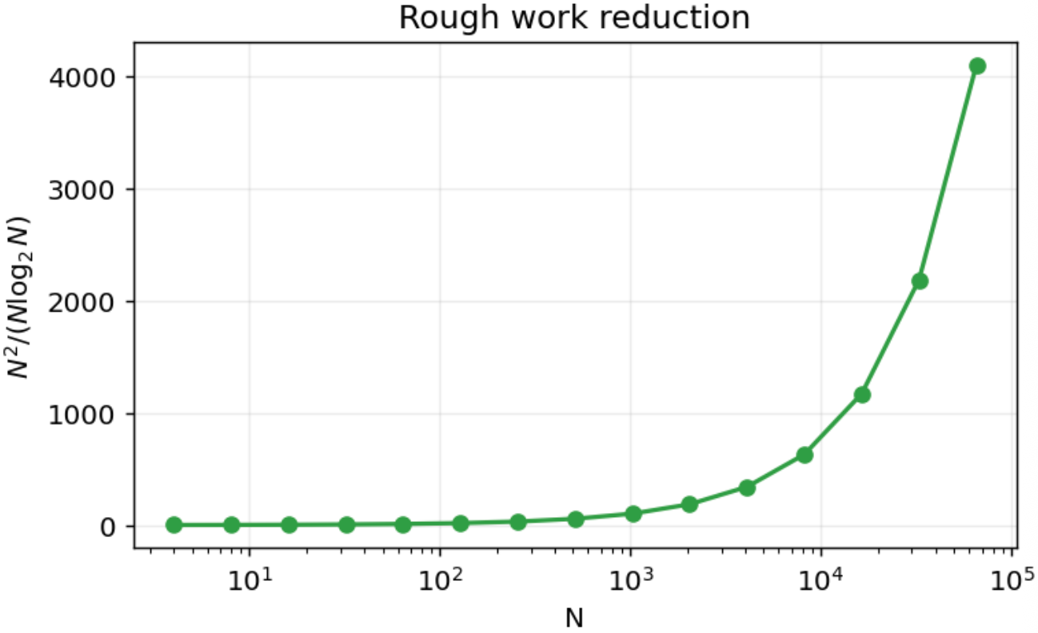
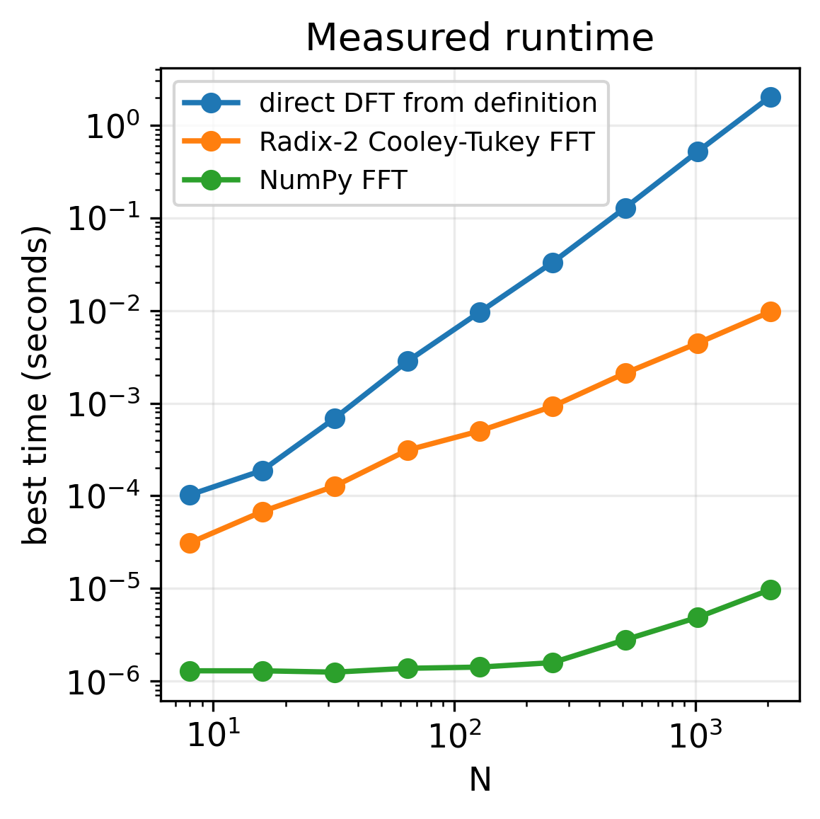
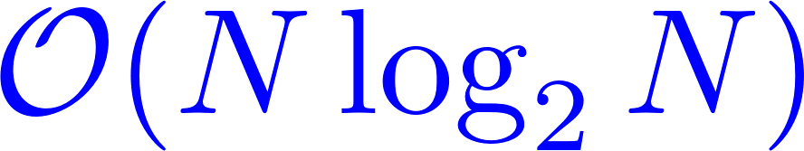
Why FFT is called fast FT?
FFT drops the number of multiplications:
drops to
In most of your cases, you will call libraries, no need to implement from scratch (except for fun)
Notes:
Use the logic chain to show it can be used for all applications at the take-home message slide to call back

Slide 11
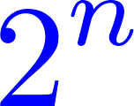
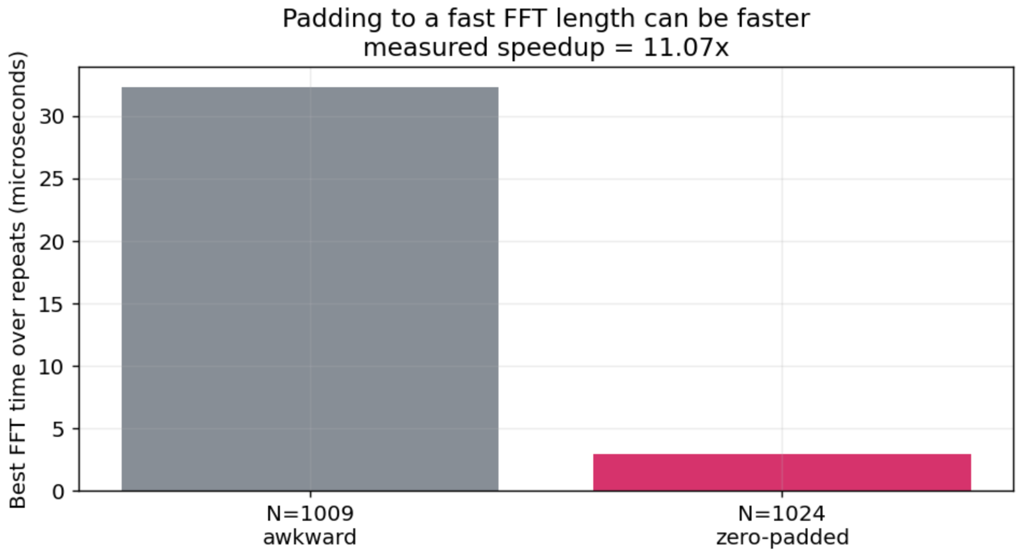
FFT can be slow → zero padding signal length to
We will see why in p.22
Pad your time-domain signal with zeros
Make a signal's length a power of two?
Modern FFT implementation handles non-power-of-two and prime lengths automatically.
Notes:
Use the logic chain to show it can be used for all applications at the take-home message slide to call back

Slide 12
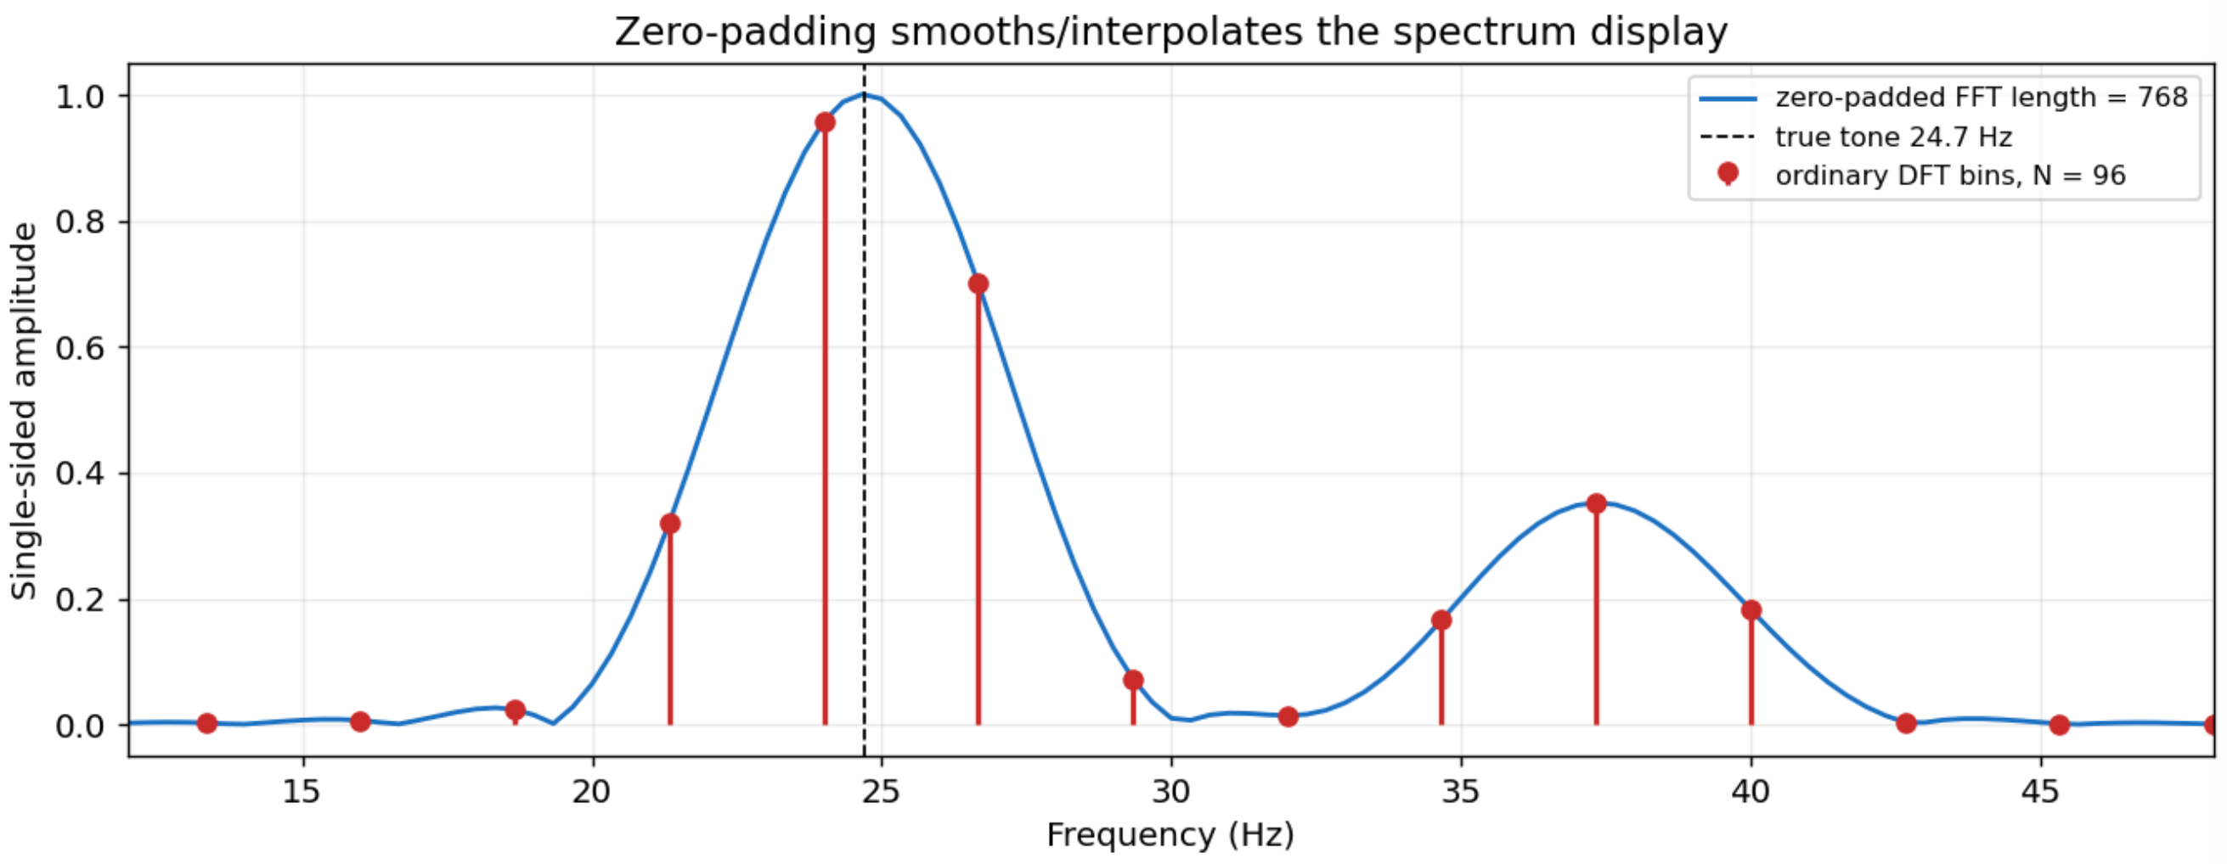
Zero padding can interpolate the frequency spectrum
Note: not increase actual frequency resolution
Easier to identify the highest peak of an isolated signal
Zero padding creates more frequency bins (visually smooths the plot)
Notes:
Use the logic chain to show it can be used for all applications at the take-home message slide to call back

Slide 13
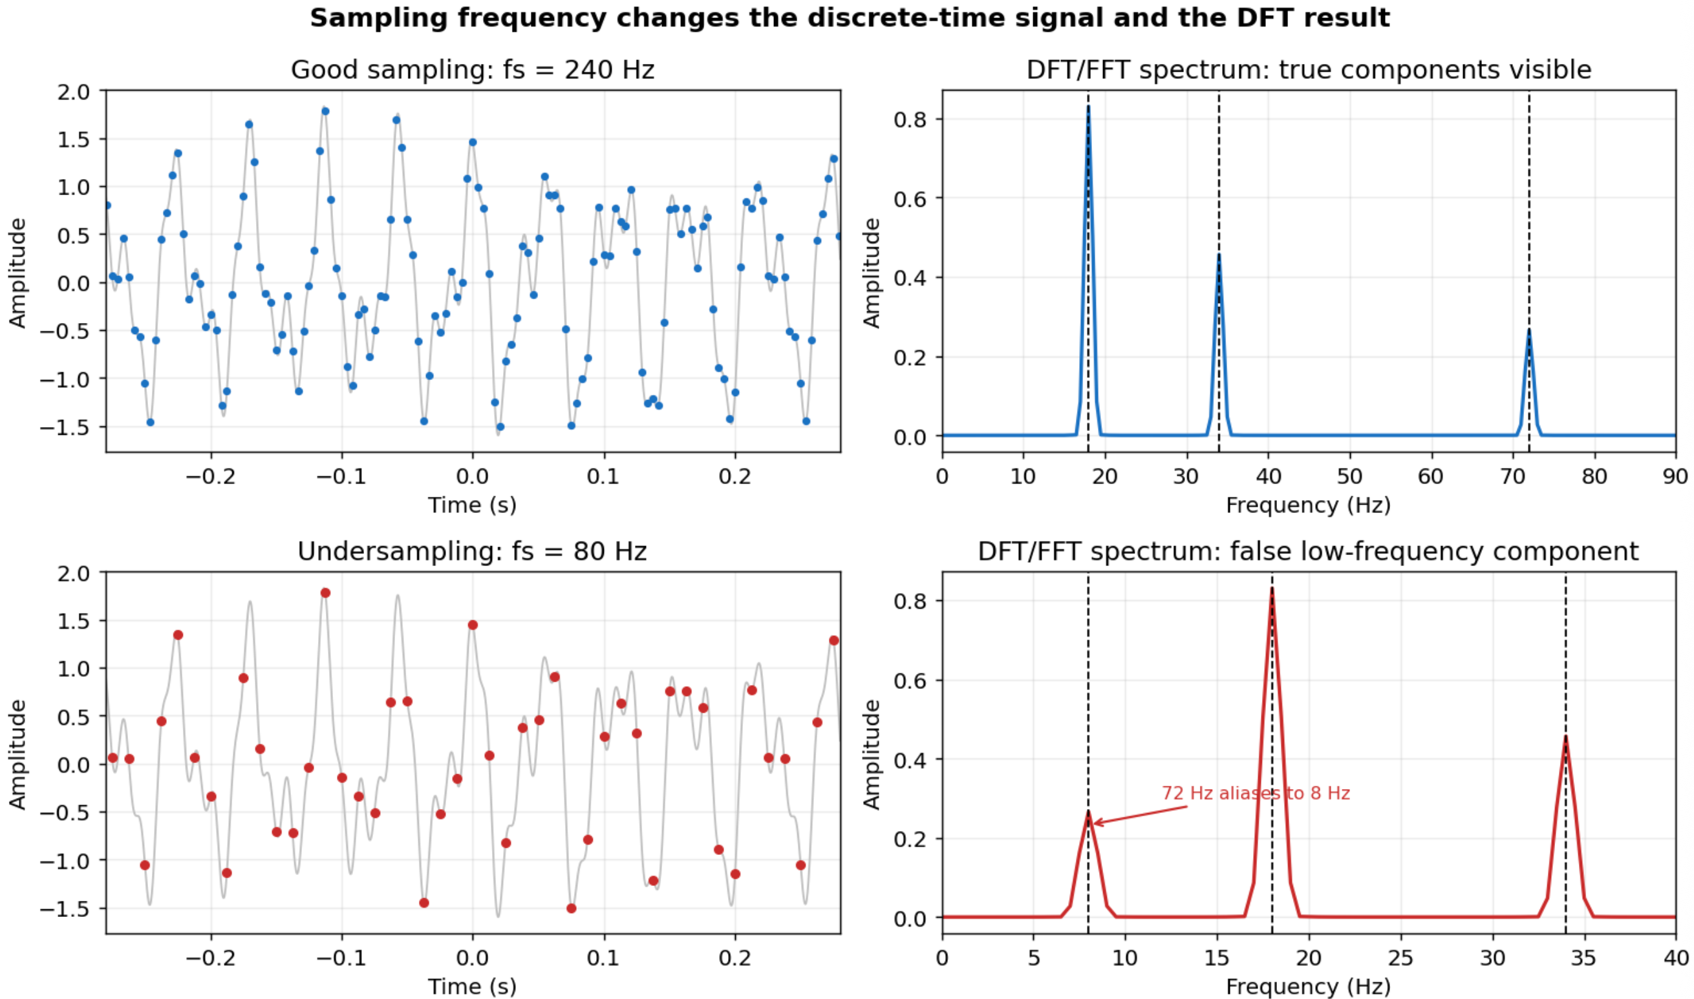
FFT can give wrong information – sampling matters
Nyquist sampling theorem:
Use 2B Hz to sample B Hz
Antialising

Slide 14


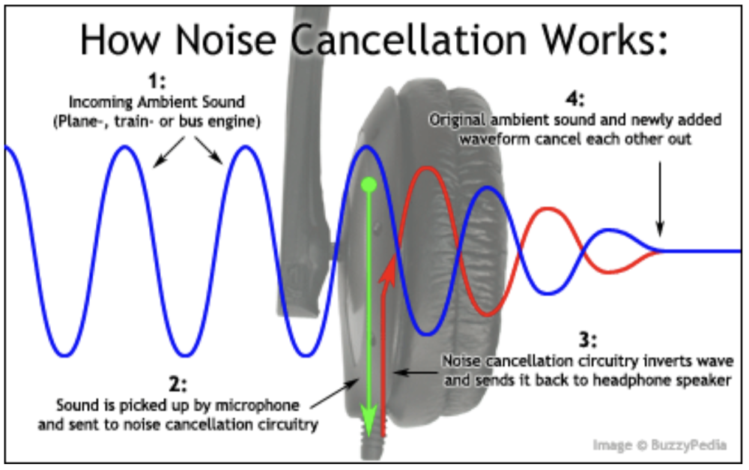
Application: Audio and Speech processing
Active noise cancelling
FFT converts the signal into individual frequency components, so we can find a way to cancel it
Have an animated step by step – struggled face to smile face in working environment
Play the audio signal – how it works
(high-pith noise)
Notes:
Use the logic chain to show it can be used for all applications at the take-home message slide to call back

Slide 15


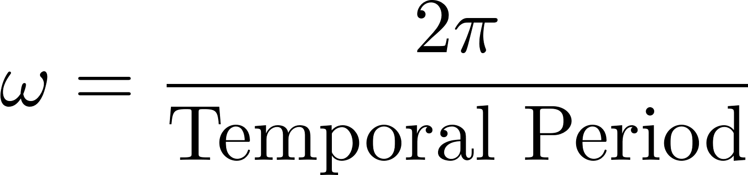
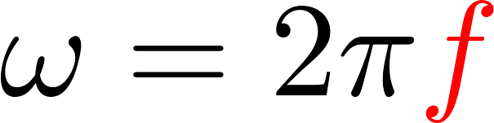
Application: Audio and Speech processing
Active noise cancelling
1D Temporal-changing Signals
time domain
temporal frequency
Cycle per sec
FFT converts the signal into individual frequency components, so we can find a way to cancel it
Have an animated step by step – struggled face to smile face in working environment
Notes:
Use the logic chain to show it can be used for all applications at the take-home message slide to call back
[\omega] = radians/sec
f = /sec or \omega = 2\pi f, f = \omega / 2\pi

Slide 16
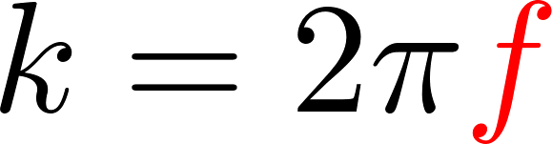
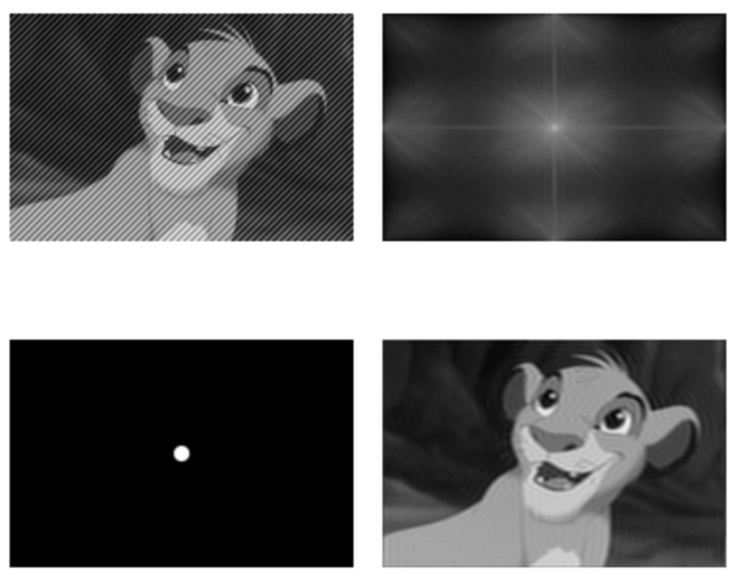
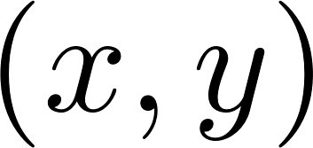
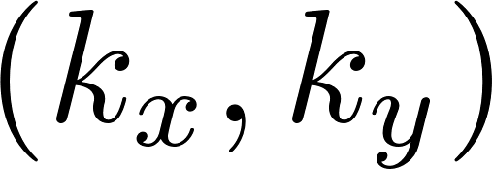
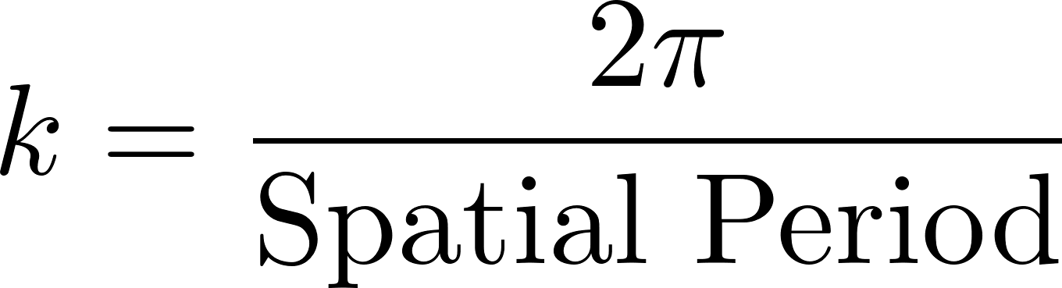
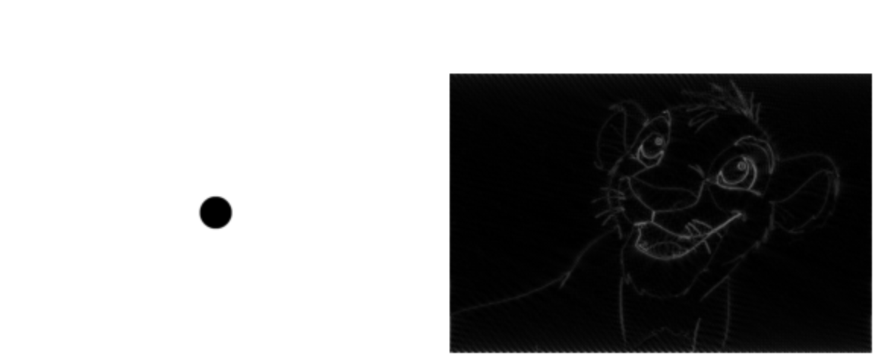
Application: Image Processing
Cycle per metre or pixel
Noisy Image (x, y)
FFT of Image
2D Static Images
spatial domain
spatial frequency
Low-pass filter
Filtered Image (x, y)
High-pass filter
Filtered Image (x, y)
Remove background noise
Fine features like edges, beard, etc
np.fft.ifft(X_ freq)
np.fft.ifft2(image_freq)
Notes:
Use the logic chain to show it can be used for all applications at the take-home message slide to call back
[k] = radian/metre or radian/pixel

Slide 17
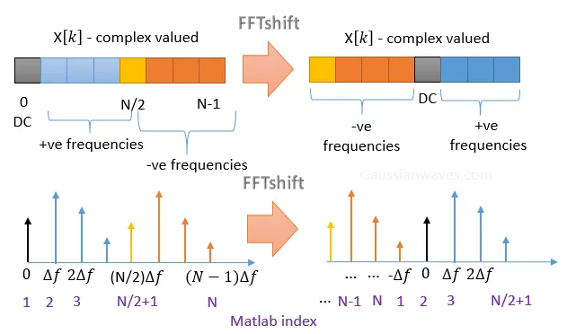
fftshift: visualise FFT data in human’s intuition (1)
Y = fft(X)
Y = fftshift(X)
X = ifft(Y)
Matlab
Y = fft2(X)
X = ifft2(Y)
# Compute the FFT
fft_output = np.fft.fft(signal)
# Compute the raw frequency bins matching the FFT layout
freqs_raw = np.fft.fftfreq(len(signal), d=1/sampling_rate)
# Shift the frequencies and the FFT output to the center
fft_shifted = np.fft.fftshift(fft_output)
freqs_shifted = np.fft.fftshift(freqs_raw)
# Get the magnitude (amplitude) of the spectrum
amplitude = np.abs(fft_shifted) / len(signal)

Slide 18





fftshift 1-D example (Matlab)
Matlab code
15 Hz example
Let’s see 2-D example, the next page
# frequency bin index, k
An easier chioce:
Python (Numpy), one line to get frequency axis (p.9)

Slide 19






fftshift: visualise FFT data in human’s intuition (2)
2D FFT case
DC component will be at the upper-left corner
# 1. Forward Transform & Shift
X_image_2d_freq = np.fft.fft2(image)
X_image_2d_freq_shifted = np.fft.fftshift(X_image_2d_freq)
# 2. Correct Inverse Transform (Add the ifftshift step)
X_image_2d_freq_unshifted = np.fft.ifftshift(X_image_2d_freq_shifted)
X_reconstructed_2d_complex = np.fft.ifft2(X_image_2d_freq_unshifted)
# 3. take the amplitude
X_reconstructed_2d_abs = np.abs(X_reconstructed_2d_complex)

Slide 20

fftshift: visualise FFT data in human’s intuition (2)
fftshift and then ifftshift back to the order that machine’s FFT prefers
# 1. Forward Transform & Shift
X_image_2d_freq = np.fft.fft2(image)
X_image_2d_freq_shifted = np.fft.fftshift(X_image_2d_freq)
# 2. Correct Inverse Transform (Add the ifftshift step)
X_image_2d_freq_unshifted = np.fft.ifftshift(X_image_2d_freq_shifted)
X_reconstructed_2d_complex = np.fft.ifft2(X_image_2d_freq_unshifted)
# 3. take the amplitude
X_reconstructed_2d_abs = np.abs(X_reconstructed_2d_complex)

Slide 21


Take-home Messages (no complicated math)
Time-domain waveform and frequency-domain spectrum
Why it is named as “fast”?
When FFT is slow? Zero padding?
Sampling rate matters – avoid antialising – Nyquist theorem
FFTshift: shift DC component to the centre
If you don’t care FFT algorithm itself, you can relax now.
Next, how does FFT work really?
Notes:
Mark the size darker

Slide 22



How does FFT work really? Cooley-Tukey FFT
"Divide and Conquer"
6 pages left
Math. Comp. 19 (1965), 297-301
James William Cooley (1926 - 2016)
John Wilder Tukey
(1915 - 2000)
Notes:
James W. Cooley – American Mathematician – PhD in Math from Columbia University (1961)
John Wilder Tukey – American Mathematician – PhD in Math from Princeton University (1939)

Slide 23



How does FFT work really? Cooley-Tukey FFT
"Divide and Conquer"
Core idea:
multiple a rotating vector ,
the signal’s amplitude unchanged.
Example:
8-point FFT
Radix-2 gets the attention
Divide a unit circle into N slices
Even
Odd
A 1-million-point signal -> DFT: 1 trillion complex multiplications -> FFT: 20 million operations
Notes:
Directly compute X(j) requires N^2 operations, operaion means “a complex multiplication followed by a complex addition”; A(k) are complex numbers
Cooley-Tukey FFT algorithm → less than 2N log_2 N operations, without requiring more data sotryage than is required for the given array A
s

Slide 24



FFT’s beauty: “Divide and Conquer”
Local index (even, odd)
[0]
[1]
[2]
[3]
[4]
[5]
[6]
[7]
1 signals of
8 points
Even
Odd
2 signals of
4 points
4 signals of
2 points

Slide 25








Butterfly Operation: 2-point FFT
"Divide and Conquer"
Example: 2-point FFT (N=2)
Radix-2 gets the attention
Time-domain
Frequency-domain
0
8
8
-8
Notes:
Directly compute X(j) requires N^2 operations, operaion means “a complex multiplication followed by a complex addition”; A(k) are complex numbers
Cooley-Tukey FFT algorithm → less than 2N log_2 N operations, without requiring more data sotryage than is required for the given array A
2-point DFT = 2-point FFT
DFT: k = 0,1,2,… N-1
FFT: k = 0,1,…, N/2 - 1

Slide 26


Example Question: how to get 2 point FFT?
10-sec
How to get 2-point FFT of this?

Slide 27





Butterfly Operation: 4-point FFT
"Divide and Conquer"
Example: 4-point FFT (N=4)
Radix-2 gets the attention
If time allows, Jupyter Notebook demo
Time-domain
Frequency-domain
2-point FFT
Even
Odd
2-point FFT
Notes:
Directly compute X(j) requires N^2 operations, operaion means “a complex multiplication followed by a complex addition”; A(k) are complex numbers
Cooley-Tukey FFT algorithm → less than 2N log_2 N operations, without requiring more data sotryage than is required for the given array A
s

Slide 28

Butterfly Operation: N-point FFT
10-sec
Input
FFT Output

Slide 29



How does FFT work really? Written in a matrix form
30-sec
64-dimensional case
Will not be in Exam ☺
Or even N-dimensional case
Prof. Gilbert Strang
(1934 - present)
More math in below link (if interested)
https://ocw.mit.edu/courses/18-06-linear-algebra-spring-2010/resources/lecture-26-complex-matrices-fast-fourier-transform/

Slide 30
Take-home Messages
Time-domain waveform to frequency-domain spectrum
Images: spatial domain to spatial frequency (2D)
Why it is named as “fast”?
When FFT is slow? Zero padding?
Sampling rate matters – avoid antialising – Nyquist theorem
A journey from DFT to FFT
Sensor (hardware)
Frequency Information
Engineering Decision
Sensor data
FFT

Slide 31



Q & A
Matrix form of FFT, 4 more slides
Thank you very much!
E-mail:
xiao.guo@uq.edu.au
xiaoguo1995.github.io
Notes:
- Thank everyone for coming in and listening!

Slide 32








How does FFT work really? Written in a matrix form
Will not be in Exam ☺
N-dimensional case for FFT
Permutation Matrix,
2N = 4 example
Odd pairs at the top of butterfly operations
Even pairs at the bottom (e.g., p.28)
Divide into 2 smaller DFTs, half of the sizes (p.24, you have done it!)
Butterfly Operations (p.28, you have seen this!)
Identity Matrix
Diagonal Matrix
The Twiddle Factor

Slide 33







How does FFT work really? Written in a matrix form
N-dimensional case for FFT
Butterfly operations
Divide
Permutation
recall (p.25):
2N = 4 example
2N = 4
Butterfly operations

Slide 34



How does FFT work really? Written in a matrix form
Now, we get everything
4-point FFT
2N = 4
We have
To obtain

Slide 35




How does FFT work really? Written in a matrix form
2N = 4 example
Recall this! (p.24)
input
shuffle
Even
Even
Odd
1st step: Permutation
Odd
2nd step: Smaller 2–point FFT
3rd step: Butterfly Operations
Final result of FFT{0, 4, 8 ,12}
p.24: the same result!

Slide 36
How does FFT work really? Written in a matrix form
2N = 4 example
Recall this! (p.24)
Even
Odd
Final result of FFT{0, 4 ,8 ,12}
p.24: the same result!

Slide 37
Q & A
Thank you very much!
E-mail:
xiao.guo@uq.edu.au
xiaoguo1995.github.io
Notes:
- Thank everyone for coming in and listening!

